Slide 1


UAV Platoons and Air Highways Theory and Implementation
Mo Chen, Frank Jiang, Claire J. Tomlin
Hybrid Systems Lab, Department of EECS, UC Berkeley
In collaboration with NASA Ames Research Center

Slide 2
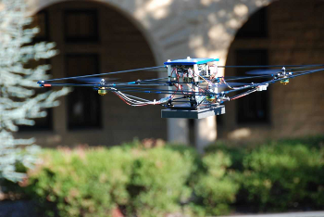

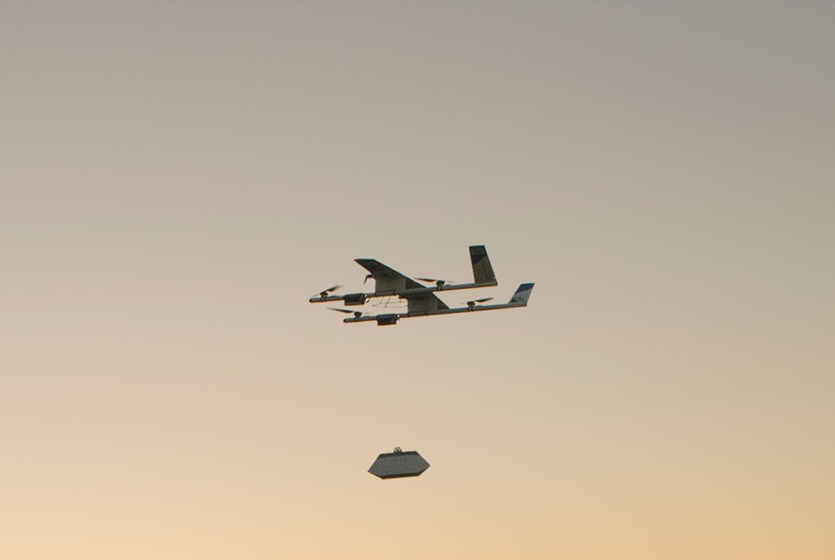
Organizing the unmanned airspace
Thousands of unmanned aerial vehicles (UAVs) flying in urban areas
Package delivery, disaster response, videography, other civil applications
Safety for humans, UAVs, other important assets
Notes:
Structural solutions to problems involving multi-agent systems simplify the overall system to allow the use of methods that are only applicable to low-dimensional systems. In addition, many automated systems require many levels of control, and often one of the levels is control by humans, so having an intuitive structure is important.
In collaboration with NASA, I have proposed having UAVs fly in platoons on air highways.
Outside of highways, the multi-vehicle management problem can be simplified by assigning priorities to each vehicle, and perform safe path planning for one vehicle at a time.
The first two structures are aimed at avoiding the situation in which multiple conflicts can occur. In the event of multiple conflicts, I have proposed using higher-level logic to coordinate pairwise avoidance maneuvers
I will now go into more details about the first part
1 min

Slide 3
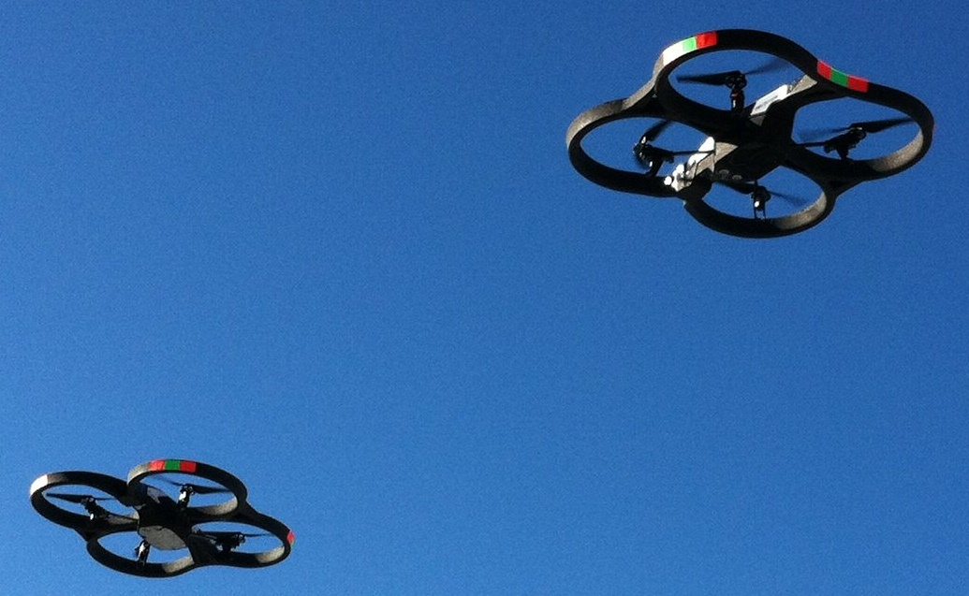
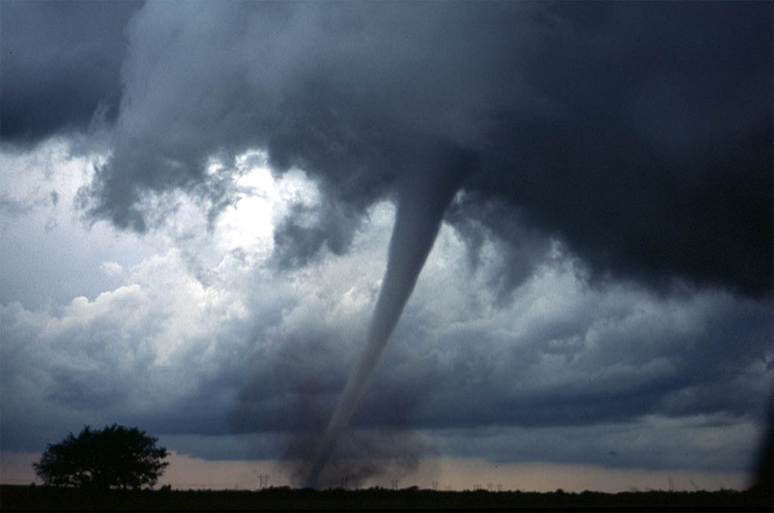
Challenges
Safety-critical
Need to account for all possible system behaviors
Most simulation-based approaches are insufficient
Complex environment
Disturbances: weather conditions, unpredictable environments, other agents
Adversarial agents
Continuous-time and nonlinear system dynamics
High-dimensional system dynamics
Notes:
Safety-critical systems are especially difficult to analyze, since all possible system behaviors need to be accounted for. This makes most simulation-based approaches insufficient.
Many practical systems operate in complex environments. These systems are affected by disturbances such as weather conditions and other unpredictable variables, as well as other agents in the same environment. In addition, some of these other agents may even be adversarial.
In addition, the systems evolve in continuous time with complex, nonlinear dynamics, and often the systems of interest have high-dimensional configuration spaces
1 min

Slide 4
Challenges
Communication
Security and privacy
Public acceptance
Other challenges
Unmanned airspace
Safety-critical
Complex environment
Continuous-time and nonlinear system dynamics
Large-scale system
Hamilton-Jacobi reachability analysis
UAV platoons and air highways
Notes:
Safety-critical systems are especially difficult to analyze, since all possible system behaviors need to be accounted for. This makes most simulation-based approaches insufficient.
Many practical systems operate in complex environments. These systems are affected by disturbances such as weather conditions and other unpredictable variables, as well as other agents in the same environment. In addition, some of these other agents may even be adversarial.
In addition, the systems evolve in continuous time with complex, nonlinear dynamics, and often the systems of interest have high-dimensional configuration spaces
1 min

Slide 5
Optimal Control and Differential Games
Powerful tools for guaranteeing performance and safety properties^{[1-3]}
Hamilton-Jacobi (HJ) reachability analysis^{[4-8]}
accounts for all possible trajectories
accounts for disturbances and adversarial behavior
applies to general nonlinear systems
Other reachability methods
Occupation measure^{[9]}
Parallelotope bundles^{[10]}
Ellipsoidal^{[11]}
Many others
[1] Varaiya ’67
[2] Tanimoto ’78
[3] Barron ’89
[4] Crandall ’84
[5] Barron ’90
[6] Mitchell ’05
[7] Bokanowski ’10
[8] Margellos ‘11
[9] Majumdar ‘14
[10] Dreossi ’16
[11] Kurzhanski ’02
Notes:
Optimal control and differential game theory present powerful tools for guaranteeing performance and safety properties of dynamical systems.
In particular, Hamilton-Jacobi reachability provides hard guarantees by accounting for all possible trajectories, disturbances and adversarial behavior, and general nonlinear systems
In addition, many other reachability methods exist
0.5 min

Slide 6

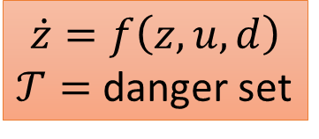
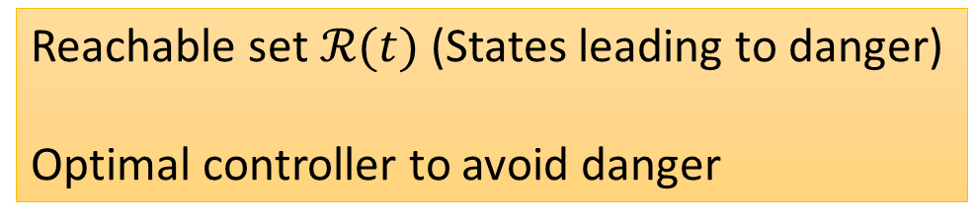
Hamilton-Jacobi (HJ) Reachability Theory
Reachable set
Target set
Reachable set $ℛ(t)$ (States leading to danger)
Optimal controller to avoid danger
$$\dot{z}=f\left(z,u,d\right)$$
$𝒯=$ danger set
Hamilton-Jacobi Equation
Notes:
In HJ reachability, we begin with the system dynamics given by an ordinary differential equation, and a target set which represents the set of unsafe states.
If our target set models the set of unsafe states, then the reachable set would represent states leading to danger. Using the optimal safety controller derived from the solution to the Hamilton-Jacobi equation, which I will describe in a couple of slides, we ensure that the system stays out of the reachable set, and therefore remain safe
0.75 min

Slide 7

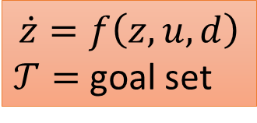
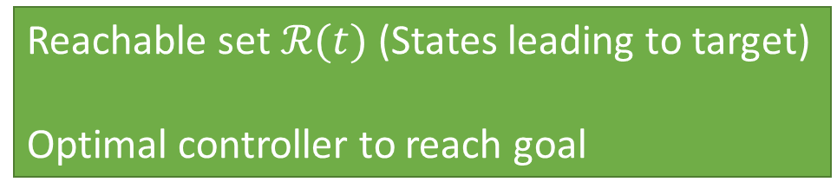
Hamilton-Jacobi (HJ) Reachability Theory
Reachable set
Target set
Reachable set $ℛ(t)$ (States leading to target)
Optimal controller to reach goal
$$\dot{z}=f\left(z,u,d\right)$$
$𝒯=$ goal set
Hamilton-Jacobi Equation
Notes:
We can also use the target set to model a set of desired states, such as a destination. In this case, the solution of the HJ equation provides an optimal controller for the system to reach the target set.
0.25 min

Slide 8
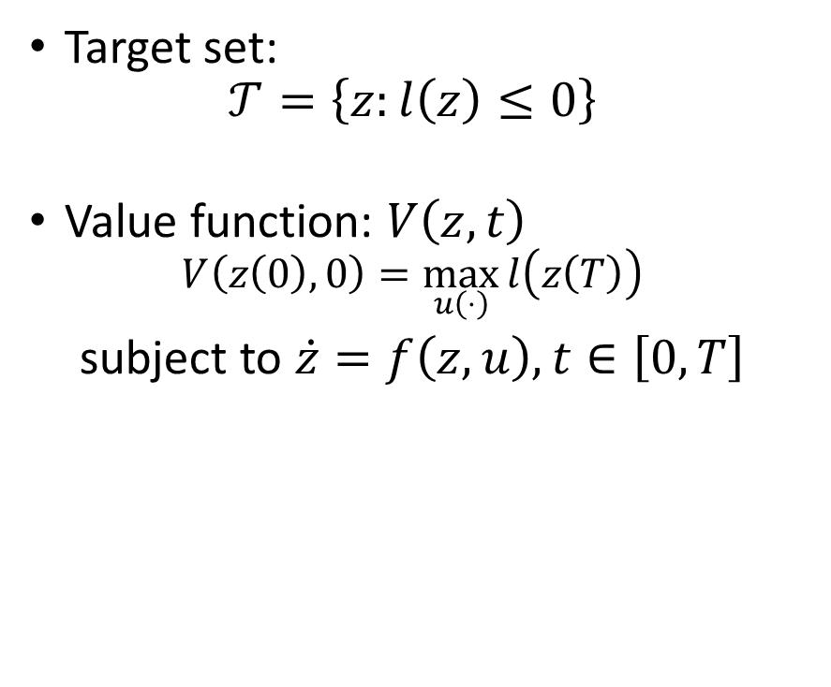
Hamilton-Jacobi (HJ) Reachability Theory
Target set:
$$𝒯=\left\{z:l\left(z\right)≤0\right\}$$
Value function: $V\left(z,t\right)$
$$V\left(z\left(0\right),0\right)=\max_{u\left(⋅\right)}{l\left(z\left(T\right)\right)}$$
subject to $\dot{z}=f\left(z,u\right),t∈\left[0,T\right]$
Can the system start from $z$ at time $t$ and reach $𝒯$ at time $0$?
If so, $z∈ℛ\left(t\right)$, the reachable set
$$ℛ\left(t\right)=\left\{z:V\left(z,t\right)≤0\right\}$$
Notes:
Consider the following 2D example. Starting with a target set, we define what’s called an implicit surface function l, such that the target set corresponds to the zero sublevel set of l.
The way we will compute the reachable set is through this optimization V(z,t) = max over the function u of l(z(T)), the value of the implicit surface function at the state at the final time
0.25 min

Slide 9
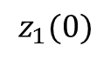
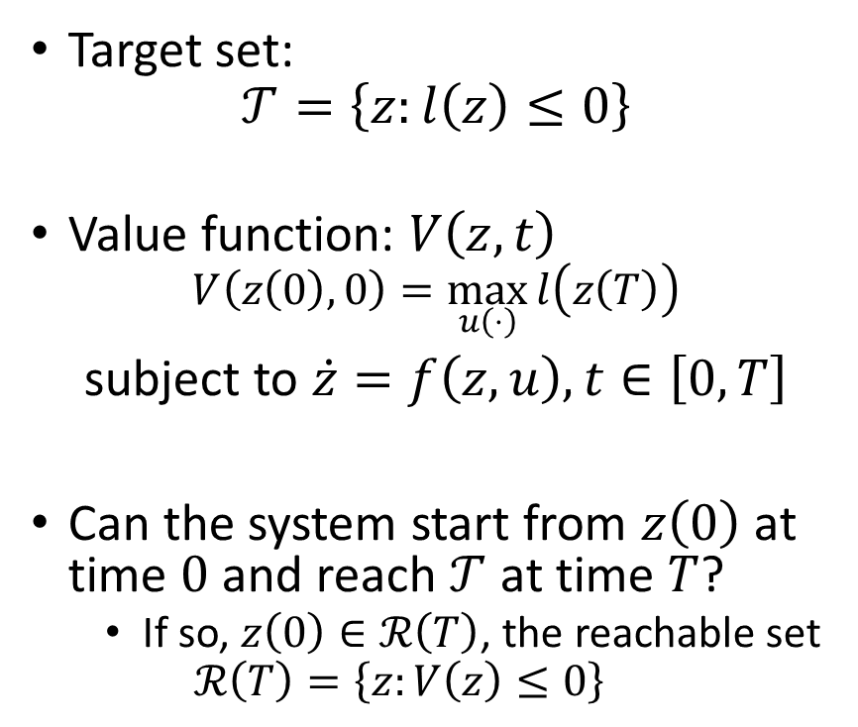
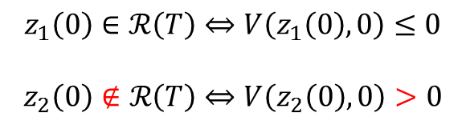
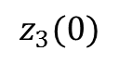
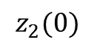
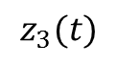
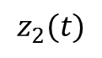
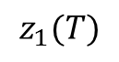
Hamilton-Jacobi (HJ) Reachability Theory
Target set:
$$𝒯=\left\{z:l\left(z\right)≤0\right\}$$
Value function: $V\left(z,t\right)$
$$V\left(z\left(0\right),0\right)=\max_{u\left(⋅\right)}{l\left(z\left(T\right)\right)}$$
subject to $\dot{z}=f\left(z,u\right),t∈\left[0,T\right]$
Can the system start from $z\left(0\right)$ at time $0$ and reach $𝒯$ at time $T$?
If so, $z\left(0\right)∈ℛ\left(T\right)$, the reachable set
$$ℛ\left(T\right)=\left\{z:V\left(z\right)≤0\right\}$$
$$z_{1}(T)$$
$$z_{3}(0)$$
$$z_{1}(0)$$
$$z_{3}(t)$$
$$z_{2}(t)$$
$$z_{2}(0)$$
$$z_{1}\left(0\right)∈ℛ\left(T\right)⇔V\left(z_{1}\left(0\right),0\right)≤0$$
$$z_{2}\left(0\right)∉ℛ\left(T\right)⇔V\left(z_{2}\left(0\right),0\right)>0$$
Notes:
Then, we can ask the question, can the system start from state z(0) at time 0 and reach the target at time T? If so, then z(0) is in the reachable set. In fact, we will see that the reachable set is actually the region of the state space where the optimal value function V is non-positive.
To get some intuition, consider this trajectory, which starts here. This trajectory actually ends up inside the target no matter what control is applied, including the control that maximizes the value of l at the final state. Therefore, z1 is in the reachable set, and V of z1 is non-positive.
Consider different trajectory, which for some controls will enter the target set, but for the optimal control that maximizes the value of l, drives the system to a positive value of l. In this case, z2 is not in the reachable set, and V is positive.
For safety guarantees, a trajectory like this, the orange one which goes through the target set, would be unsafe if the target set is a set of states that needs to be avoided. However, with this optimization problem, which only takes into account the value of l at the end of the time horizon, z3 would not be considered to be in the reachable set.
0.25 min

Slide 10
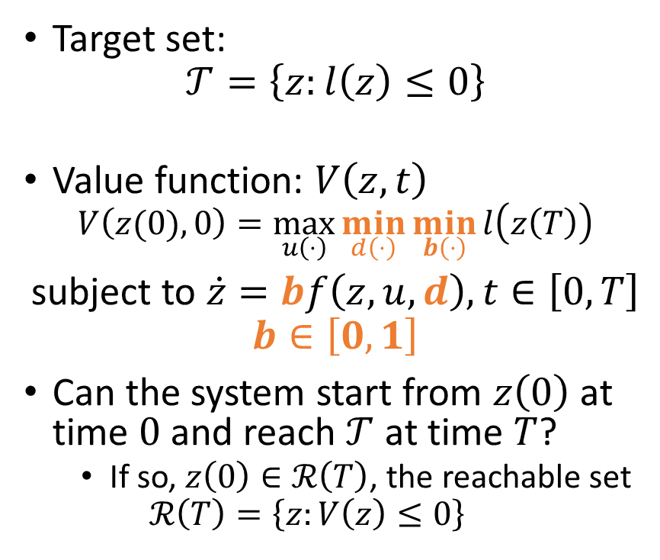
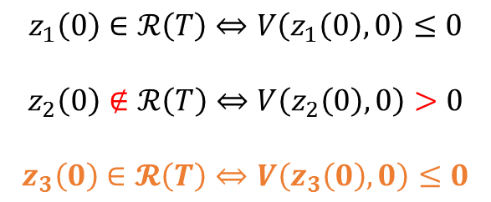
Hamilton-Jacobi (HJ) Reachability Theory
Target set:
$$𝒯=\left\{z:l\left(z\right)≤0\right\}$$
Value function: $V\left(z,t\right)$
$$V\left(z(0),0\right)=\max_{u\left(⋅\right)}{\min_{d\left(⋅\right)}\min_{b\left(⋅\right)}{l\left(z\left(T\right)\right)}}$$
subject to $\dot{z}=bf\left(z,u,d\right),t∈\left[0,T\right]$
$$b∈\left[0,1\right]$$
Can the system start from $z\left(0\right)$ at time $0$ and reach $𝒯$ at time $T$?
If so, $z\left(0\right)∈ℛ\left(T\right)$, the reachable set
$$ℛ\left(T\right)=\left\{z:V\left(z\right)≤0\right\}$$
$$z_{1}(T)$$
$$z_{3}(0)$$
$$z_{1}(0)$$
$$z_{3}(t)$$
$$z_{2}(t)$$
$$z_{2}(0)$$
$$z_{1}\left(0\right)∈ℛ\left(T\right)⇔V\left(z_{1}\left(0\right),0\right)≤0$$
$$z_{2}\left(0\right)∉ℛ\left(T\right)⇔V\left(z_{2}\left(0\right),0\right)>0$$
$$z_{3}\left(0\right)∈𝓡\left(T\right)⇔V\left(z_{3}\left(0\right),0\right)≤0$$
Notes:
To capture this, as well as the presence of disturbances, we can modify the optimization as follows, with minimizations over the disturbance, as well as over an auxiliary variable b which can freeze the system dynamics when the trajectory enters the target. With this modified optimization, z3 would be inside the reachable set, and V at z3 would be non-positive.
So now the question is how to compute V
0.25 min

Slide 11
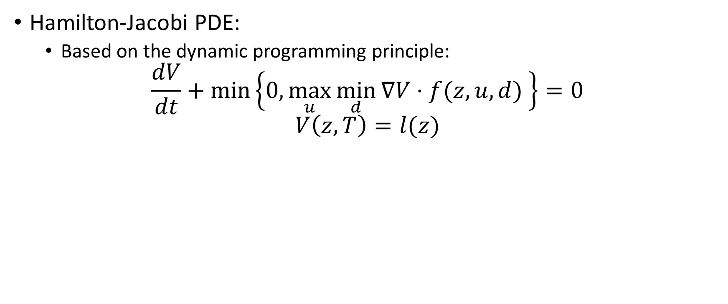
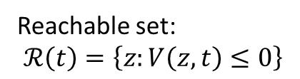
Hamilton-Jacobi (HJ) Reachability Theory
Hamilton-Jacobi PDE:
Based on the dynamic programming principle:
$$\frac{dV}{dt}+\min\left\{0,\max_{u}{\min_{d}{∇V⋅f(z,u,d) }}\right\}=0$$
$$V\left(z,T\right)=l(z)$$
Reachable set:
$$ℛ\left(t\right)=\left\{z:V\left(z,t\right)≤0\right\}$$
Notes:
Intuitively, the reachable set can be computed using the dynamic principle. We start with the reachable set being the same as the target set, and then add states very close to the target set that will reach the target set no matter the control. We then continue this process recursively. In terms of the value function V, the value of V at these points become negative. Skipping over further details, V can be computed by solving the Hamilton-Jacobi partial differential equation.
The implicit surface function acts as the final condition to the Hamilton-Jacobi PDE. The PDF is then solved backward in time to obtain V, which represents the reachable set.
1 min

Slide 12
5 minutes for explaining reachable sets

Slide 13
Reachability for small-scale systems
Pairwise collision avoidance ^{[Mitchell et al. TAC’05]}
Automated aerial refueling ^{[Ding et al. CDC’08]}
Aircraft auto-landing ^{[Bayen et al. JGCD’07]} and aircraft forced landing ^{[Coombes et al. JIRS’14]}
Evolution of breast cancer cells ^{[Yang et al. HSCC’02]}
Notes:
In the past decade, Hamilton-Jacobi reachability has been successfully used to analyze small-scale problems such as pairwise collision avoidance, automated aerial refueling, aircraft landing, and evolution of breast cancer cells.
0.5 min

Slide 14
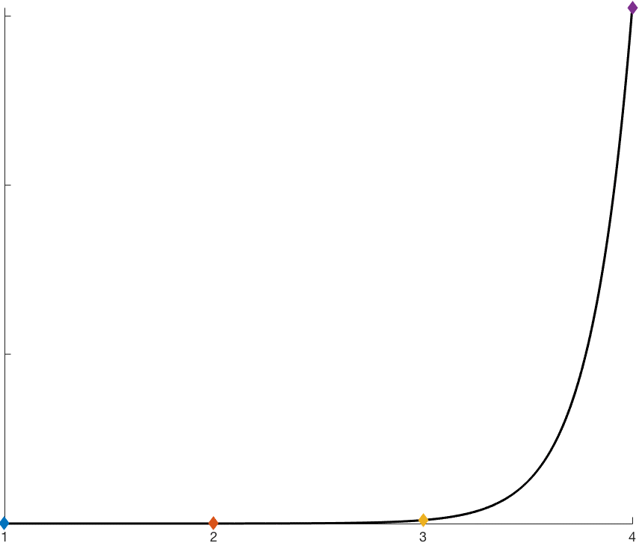
Approximate computation times
4D: 0.5 - 20 hours
5D and higher:
intractable
computation time
1D: < 0.1s
2D: 0.1 – 5s
3D: 0.5 – 10 min
number of system dimensions
Notes:
To put the exponentially scaling computational complexity into perspective, here are typical times needed to compute a reachable set. 1D reachable sets can be computed in real-time. For 2D systems, reachable sets can be computed in a few seconds, and in some cases this means in real-time.
3D reachable sets can take anywhere from half a minute to 10 minutes, and 4D reachable sets typically take many hours.
Due to computation time and memory limitations, reachable sets of 5 or more dimensions are considered intractable to compute.
0.75 min

Slide 15
Relevant current work in reachability
General system decomposition
Dynamics involving integrators
Approximation techniques

Slide 16
Challenges
Communication
Security and privacy
Public acceptance
Other challenges
Unmanned airspace
Safety-critical
Complex environment
Continuous-time and nonlinear system dynamics
Large-scale system
Hamilton-Jacobi reachability analysis
UAV platoons and air highways
Notes:
Safety-critical systems are especially difficult to analyze, since all possible system behaviors need to be accounted for. This makes most simulation-based approaches insufficient.
Many practical systems operate in complex environments. These systems are affected by disturbances such as weather conditions and other unpredictable variables, as well as other agents in the same environment. In addition, some of these other agents may even be adversarial.
In addition, the systems evolve in continuous time with complex, nonlinear dynamics, and often the systems of interest have high-dimensional configuration spaces
1 min

Slide 17
Structural solutions in UAS traffic management
Enable the use of formal verification for small-scale systems
Basic reachability formulation
Facilitate human participation
Primary UTM mantras^{[1]}
“Flexibility where possible and structure where necessary”
“Geographic needs and use cases determine airspace performance requirements
[1] T. Prevot, J. Rios, P. Kopardekar, J. E. Robinson III, M. Johnson, and J. Jung, “UAS Traffic Management (UTM) Concept of Operations to Safely Enable Low Altitude Flight Operations,” in 16th AIAA Aviation Technology, Integration, and Operations Conference, 2016.
Notes:
Our structural solution involving air highways enable the use of formal verification tools, which are computationally expensive and only tractable for small-scale systems. In particular, the structure allows the basic reachability formulation to be used.
In addition, air highways structures make airspace management intuitive, facilitating human participation.
Our analysis is not meant to be exhaustive, and our project is mainly technical, and isn’t necessarily an indication of any future policies. However, we do take the he primary mantras of UTM into account. These are flexibility where possible and structure where necessary. In addition, geographic needs and use cases determine the airspace performance requirements.

Slide 18
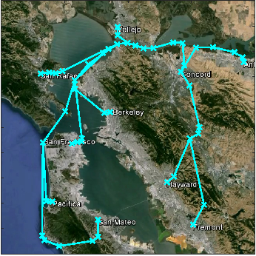
Real-time air highway placement
Geographic map → cost map
Cost map → optimal paths
Optimal paths → air highways
Notes:
The first part of the UTM project is to perform real-time placement of air highways, which can thought of as virtual pathways in the sky that UAVs are required to fly in.
For this part, we start with an area of a region, say the San Francisco Bay Area, and convert it into a cost map that represents the desirability of flying in any region
Given this cost map, the cost-minimizing paths from origin to destinations can be computed, shown in red.
Since the space is 2D, the computation can actually be done in real-time. So if for any reason, the cost map needs to change, the highways can be updated right away.
Putting the map back on, we see this air highway structure over the Bay Area.
1.5 min

Slide 19
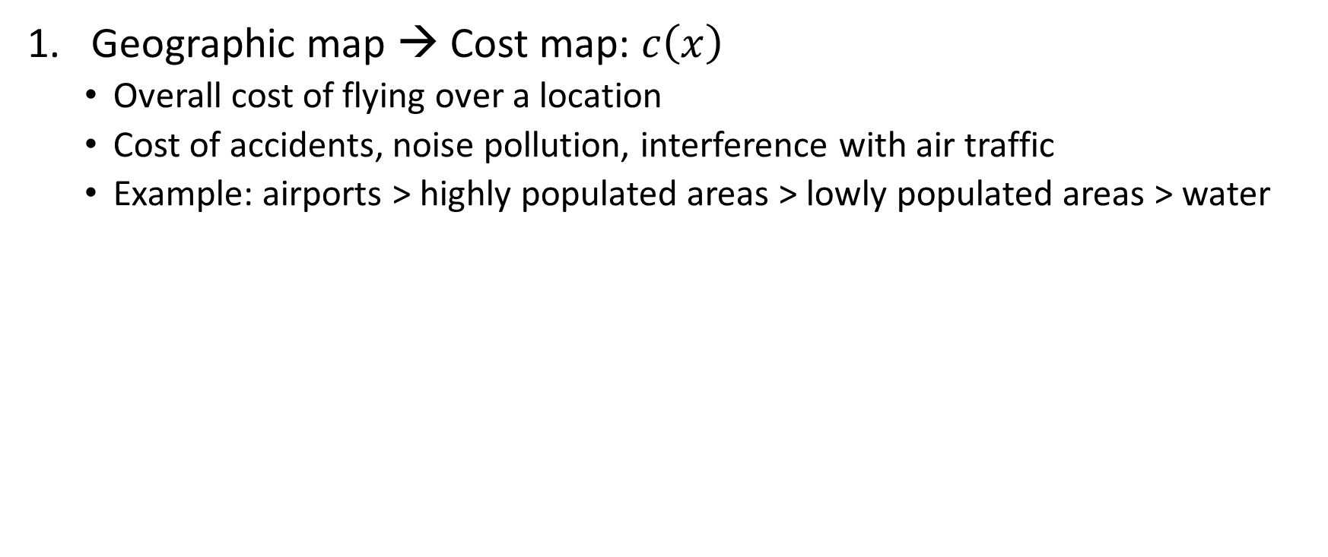
Real-time air highway placement
Geographic map → Cost map: $c\left(x\right)$
Overall cost of flying over a location
Cost of accidents, noise pollution, interference with air traffic
Example: airports > highly populated areas > lowly populated areas > water
Notes:
Let’s look at the first step in a bit more detail. Here, we start with a geographic map, and assign a cost map to it. The cost map can take into account any factors such as population density, proximity to airports, and any kind of cost or risk of flying over an area. As an example, I have assigned the highest cost to regions around the two airports, second highest cost to densely populated regions, and lowest cost to areas above water, in yellow.
Of course, the cost map does not have to be exactly the same as this example. In general, government agencies would probably be in charge of defining the cost map.

Slide 20
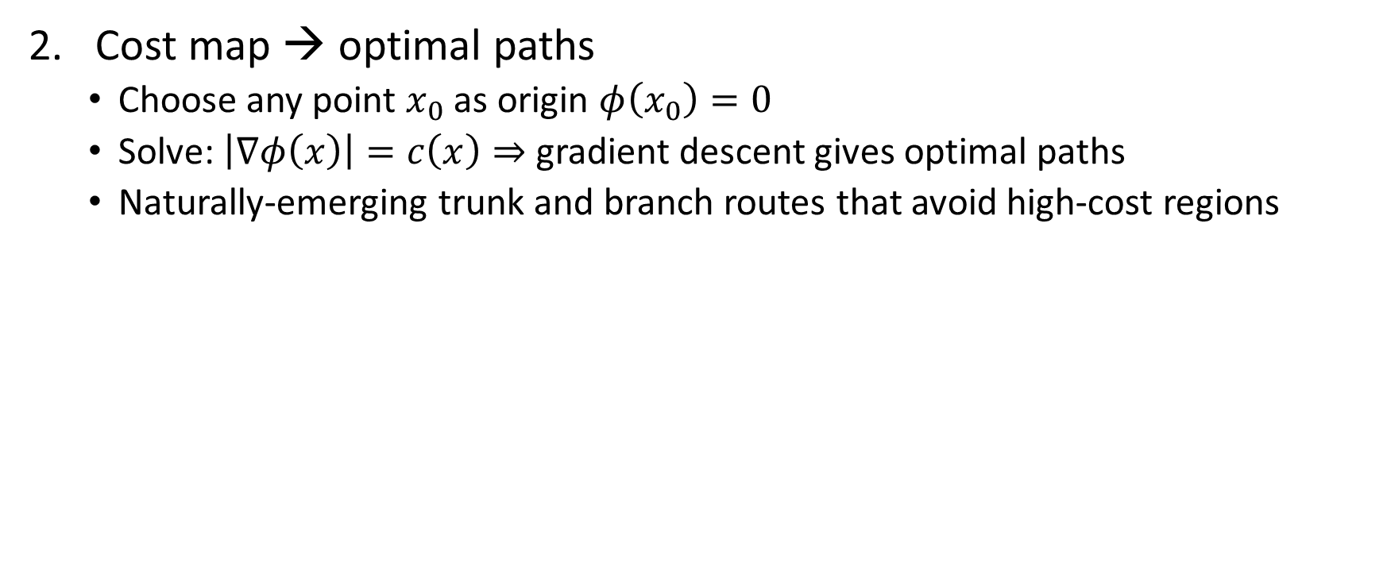
Real-time air highway placement
Cost map → optimal paths
Choose any point $x_{0}$ as origin $φ\left(x_{0}\right)=0$
Solve: $\left|∇φ\left(x\right)\right|=c\left(x\right)⇒$ gradient descent gives optimal paths
Naturally-emerging trunk and branch routes that avoid high-cost regions
Notes:
The second step is to compute optimal paths, paths that minimize the cost from going from an origin point to destination points. To do this, we choose any point x_0 as the origin, and set a function phi to be 0 at x0. Phi represents the optimal cumulative cost from the origin to any point on the map, and is the solution to the Eikonal equation here. This equation also comes from the dynamic programming principle.
After phi is computed, gradient descent can then be used starting from any destination, and the resulting paths are the cost-minimizing paths shown in red.
Notice that the paths naturally form trunks and branches, and the length of path in high cost regions is minimized.

Slide 21
Real-time air highway placement
Optimal paths → air highways
Post-process optimal paths to obtain straight line segments
UAVs fly on air highways in platoons
Notes:
The red paths serve as a guideline for where air highways can be placed. For example, if air highways are straight line paths, then they would look something like this over the map.

Slide 22
6 minutes to talk about air highways

Slide 23
UAV Platooning
Single-file formation
Reduces likelihood of multiple conflicts
Increases reliability of pairwise collision avoidance
Intuitive to monitor
Hybrid systems model
Reachability-based mode transitions
Defines all goal-satisfaction controllers
Safety controller wrapped around goal-satisfaction controllers
Leave highway
Follow highway
Leader
Leader of platoon
Create new platoon
Merge onto highway
Join platoon in front
Follow platoon
Free
Vehicle not in a platoon or on a highway
Follower
Member of platoon
Join platoon
Leave highway
Faulty
Emergency maneuver
Notes:
Along the air highways, UAVs would fly in platoons of single files. This reduces the likelihood of multiple conflicts between vehicles, and increases the reliability of pairwise collision avoidance. In addition, a highway structure with UAVs in platoons is easy to monitor, and facilitates human intervention whenever needed.
The highway structure imposes restrictions on what each vehicle is allowed to do depending on the role of the vehicle on the highway system. This is modeled by a hybrid system, with the free mode for vehicles not on the highways, leader mode for platoon leaders, and follower mode for vehicles that are following a leader. The safety and success of transitions between the modes are guaranteed by reachability
For example, transitions to the leader mode involve reaching a target set defined in the absolute coordinates. Transitions to the follower mode involve reaching a target set defined in the coordinates relative to the platoon leader. Other maneuvers such as following the highway can be done using simpler controllers such as the linear quadratic regulator or model predictive controller.
A safety controller that ensures pairwise collision avoidance is wrapped around all other controllers
1.5 min

Slide 24
Goal-satisfaction controllers from reachable sets
Merging onto a highway
Target set: desired merging point and relative velocity
Reachable set: set of states that can reach target set
Joining platoon on highway
Target set: desired merging point in terms of relative coordinates
Reachable set: set of states in relative coordinates that can reach target set
Controller
Take straight line towards target until vehicle is inside reachable set
Use optimal control from reachable set once vehicle is inside reachable set
Leader
Leader of platoon
Merge onto highway
Free
Vehicle not in a platoon or on a highway
Notes:
We can now apply Hamilton-Jacobi reachability to construct liveness controllers. For each controller, we can simply specify the target set, compute the reachable set, and the obtain the optimal control.
For the merging onto highway operation, we define the target set to be the position of the desired merging point, along with the desired heading. This operation allows a free vehicle to become a leader

Slide 25
Goal-satisfaction controllers from reachable sets
Merging onto a highway
Target set: desired merging point and relative velocity
Reachable set: set of states that can reach target set
Joining platoon on highway
Target set: desired merging point in terms of relative coordinates
Reachable set: set of states in relative coordinates that can reach target set
Controller
Take straight line towards target until vehicle is inside reachable set
Use optimal control from reachable set once vehicle is inside reachable set
Free
Vehicle not in a platoon or on a highway
Follower
Member of platoon
Join platoon
Notes:
For the joining platoon operation, which allows a leader or a free vehicle to become a follower, we define the target set to be a position behind a platoon leader, with small relative velocity with respect to the leader.

Slide 26
Safety controllers
Collision avoidance
Target set: collision box in relative states plus (union) velocity limits
Reachable set: set of states in relative coordinates that will hit target set assuming worst case disturbance
Controller
Use goal-satisfaction controller if safe
Use safety controller if not safe
Notes:
Whenever a vehicle is outside of the safety reachable set of other vehicles, it may use a liveness controller; otherwise, the safety controller must be used.

Slide 27
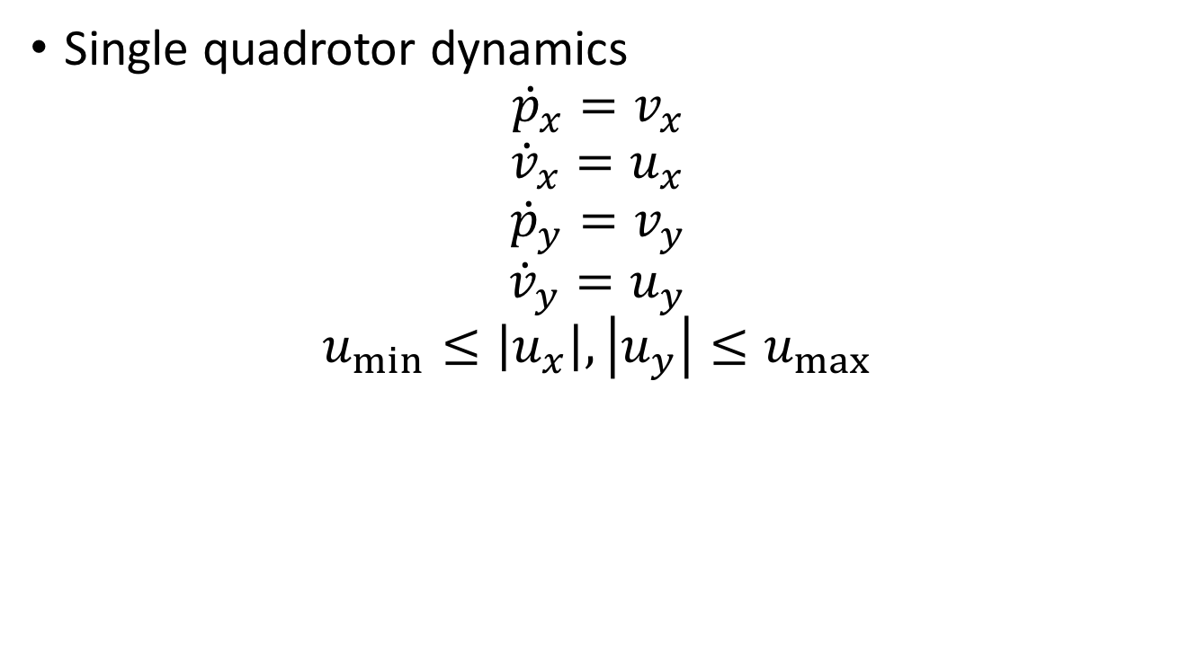
Dynamics
Single quadrotor dynamics
$${\dot{p}}_{x}=v_{x}$$
$${\dot{v}}_{x}=u_{x}$$
$${\dot{p}}_{y}=v_{y}$$
$${\dot{v}}_{y}=u_{y}$$
$$u_{min}≤\left|u_{x}\right|,\left|u_{y}\right|≤u_{max}$$
Notes:
Consider a quadrotor modeled using double integrator dynamics. The quadrotor has a bounded acceleration in both the x and y directions. This model is used for computing the reachable set for merging onto the highway
i is evader, j is pursuer

Slide 28
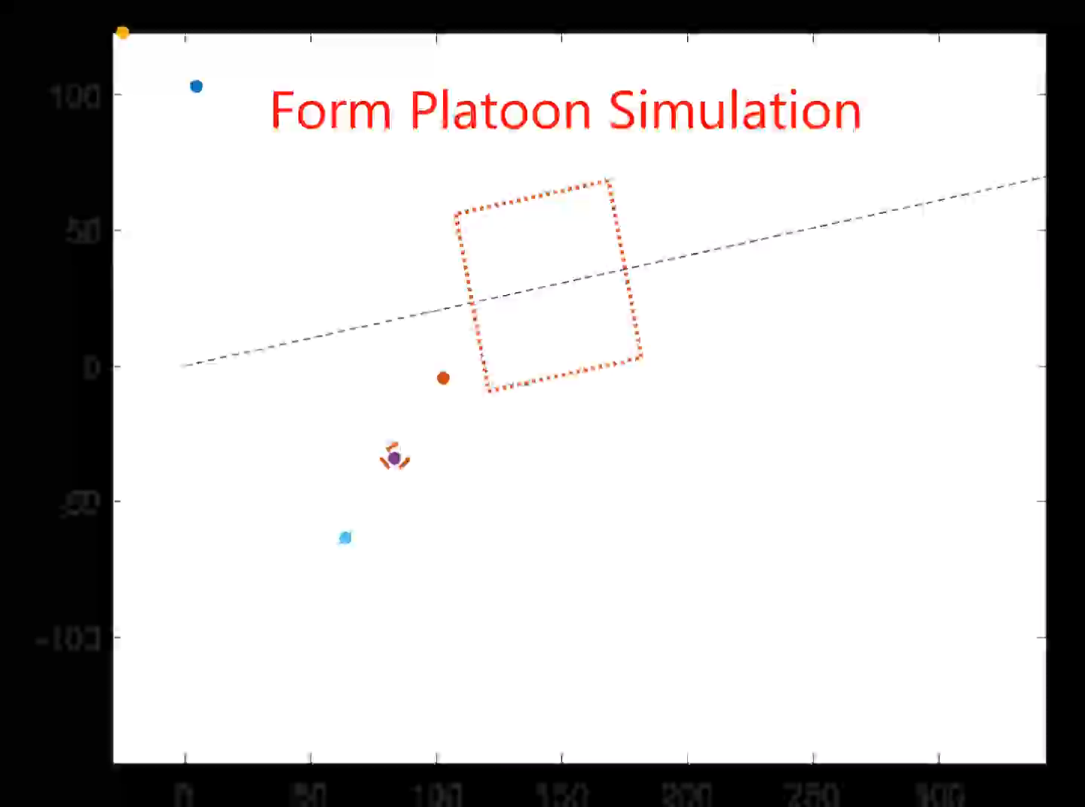
Simulation: Forming a platoon
Safety reachable set:
dashed boundaries
Liveness reachable set:
dotted boundaries
Sequence of events:
First vehicle merges onto highway
Second vehicle joins the platoon created by the first vehicle
The rest of the vehicles join the platoon
Notes:
To understand the behavior emerging from the hybrid systems mode and to illustrate the use of reachability, we’ll look at a few simulations. The first one involves a group of five vehicles forming a platoon on a highway.
Initially, the orange vehicle is tries to reach a target specifying a position and velocity on the highway. To do this, the vehicle first enters the orange reachable set. To ensure safety, the vehicle must stay outside of all the safety reachable sets around the other vehicles. Only the safety reachable set around the purple vehicle is shown here. All the reachable sets are four dimensional, and we’re look at their 2D slices, taken at the vehicles’ velocities. So as the vehicles change velocities you’ll see the slices change as well.
After the first vehicle gets on the highway, a platoon is formed. Next, the purple vehicle begins joining the platoon. This is done by using a reachable set for reaching a position relative to the platoon leader. Again, safety is ensured if the purple vehicle stays outside of the safety reachable sets around other vehicles. The one around the platoon leader is shown here.
The rest of the vehicles follow the same process to get into a platoon on the highway.
2 min

Slide 29
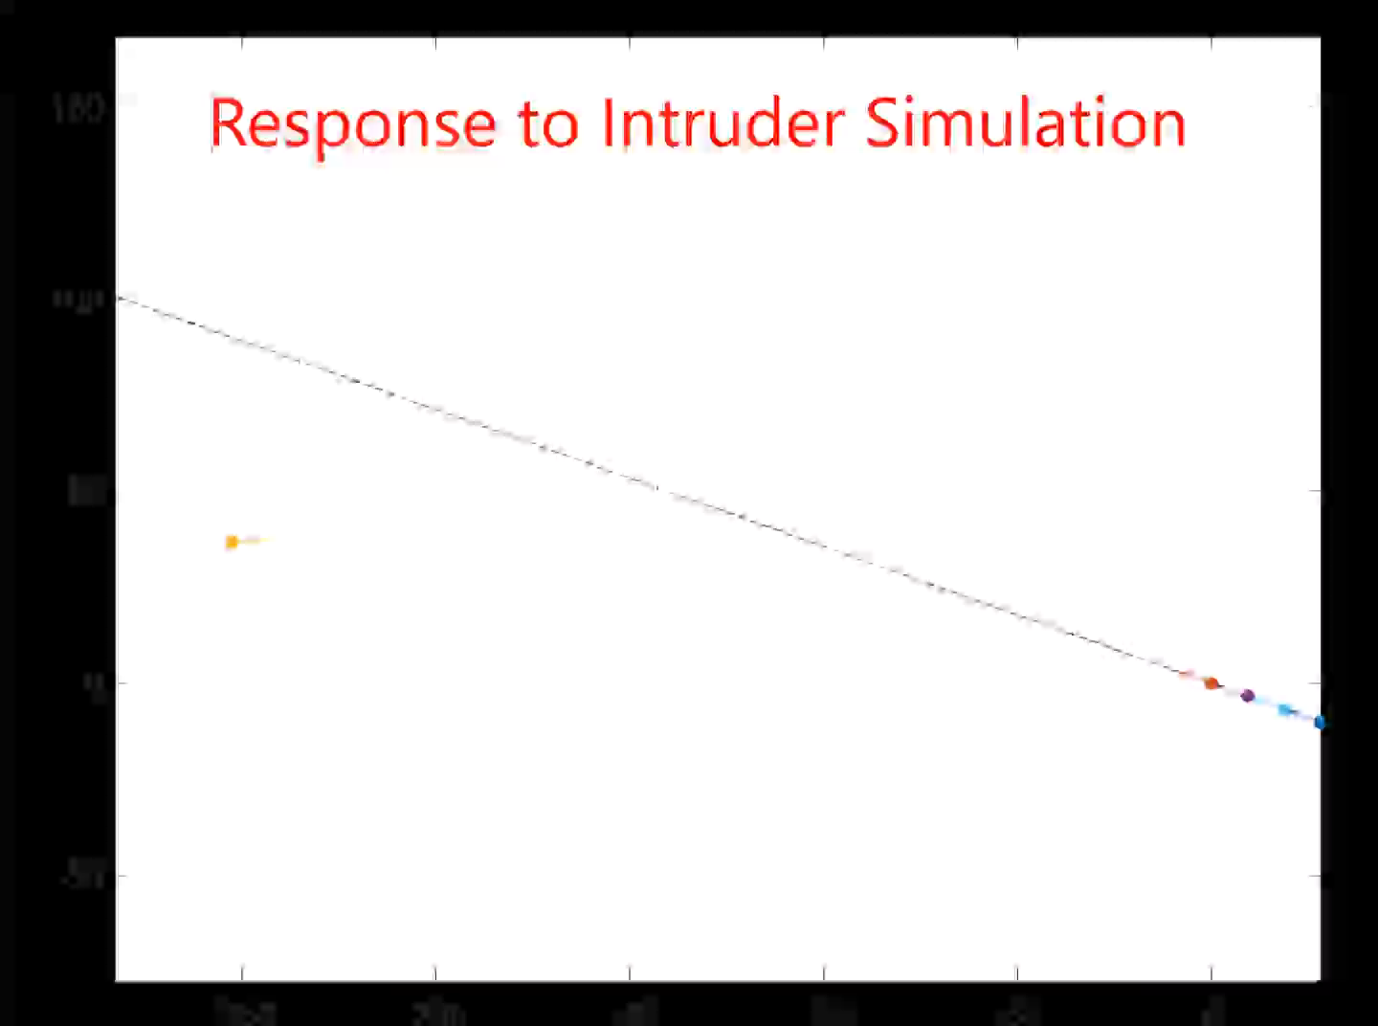
Simulation: Response to intruder
Vehicles automatically perform maneuvers to avoid collision
Safety is guaranteed by reachable set
Vehicles automatically re-establish formation
Liveness reachable sets guarantee success
Notes:
In the second simulation, we have an intruder, the yellow vehicle. When the intruder gets close enough to the platoon of vehicles, the vehicles first disperse, and then reform the platoon. The notion of “close enough” is quantified by the safety reachable set, which is defined as the set of relative states from which the intruder has a control strategy to cause a collision.
0.75 min

Slide 30
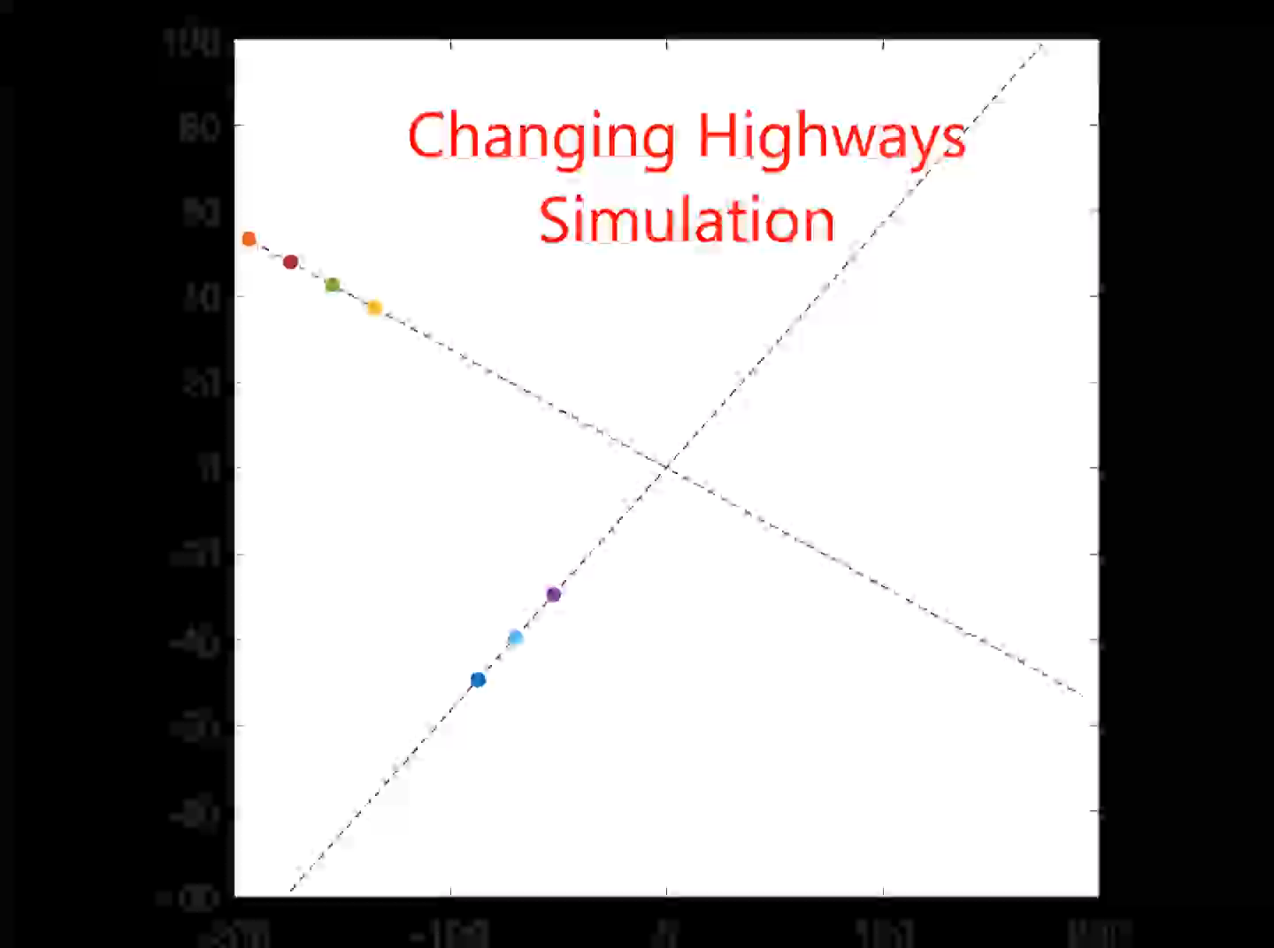
Simulation: Changing highways
Two highways
One with a 3-vehicle platoon
The other with a 4-vehicle platoon.
2 vehicles in the 4-vehicle platoon changes highways
The remaining 2 vehicles remain on the same highway.
Notes:
The hybrid system models of the vehicles, plus the reachability-based mode transitions, are used all together in this simulation showing vehicles changing highways. What we’ll see is that two of the vehicles in the four-vehicle platoon will change highways and join the three-vehicle platoon to form a five-vehicle platoon.
0.75 min

Slide 31
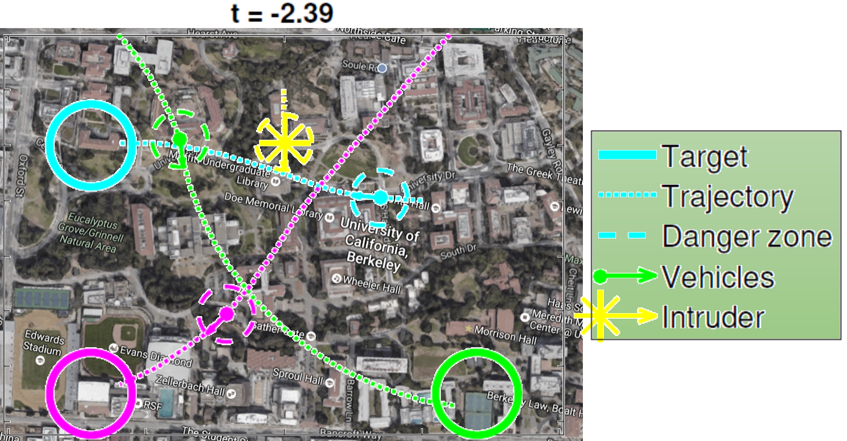
Future work
Highway intersections
Off the highway
Suitable level of abstraction
Role of altitude

Slide 32
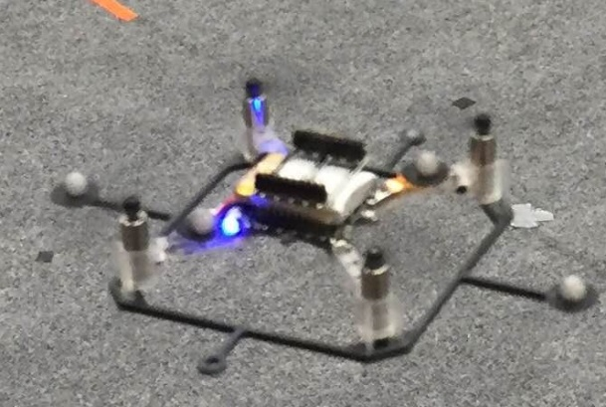
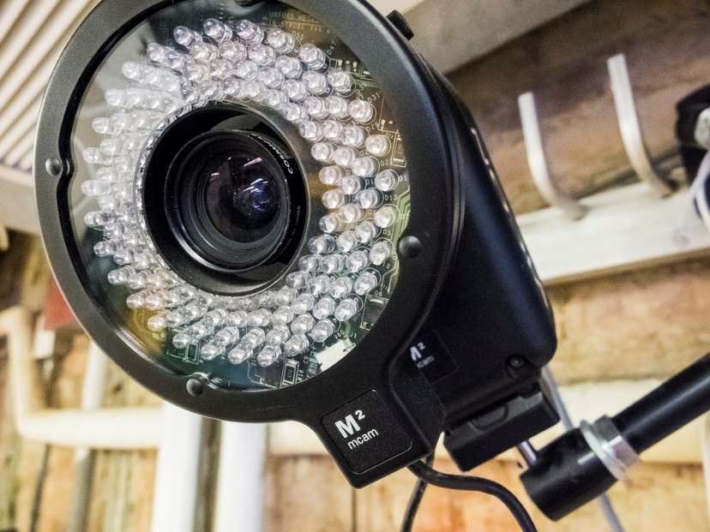
Experimental setup
Crazyflies
Vicon system and ROS
Change to goal-satisfaction controller
Notes:
Currently, the air highways and the platooning concept is being implemented in hardware using crazyflies. In the quadrotor lab at Berkeley, we use the vicon system to extract state information, and run experiments under ROS. Here, we use a communications architecture in which vehicles normally use a controller responsible for mode transitions and highway following. A traffic flow manager, TFM, monitors the safety of the vehicles, and takes over control to maintain separation of the vehicles when needed.
0.5 min

Slide 33
Crazyflies
Specifications
Relevant controllers
Notes:
Currently, the air highways and the platooning concept is being implemented in hardware using crazyflies. In the quadrotor lab at Berkeley, we use the vicon system to extract state information, and run experiments under ROS. Here, we use a communications architecture in which vehicles normally use a controller responsible for mode transitions and highway following. A traffic flow manager, TFM, monitors the safety of the vehicles, and takes over control to maintain separation of the vehicles when needed.
0.5 min

Slide 34
Crazyflies
Dynamic model

Slide 35
Linear Quadratic Regulator Controller

Slide 36
Flying multiple crazyflies

Slide 37
Architecture
Safety and goal-satisfaction

Slide 38
Controller blending
Why this is needed
Blend safety and goal-satisfaction controllers

Slide 39
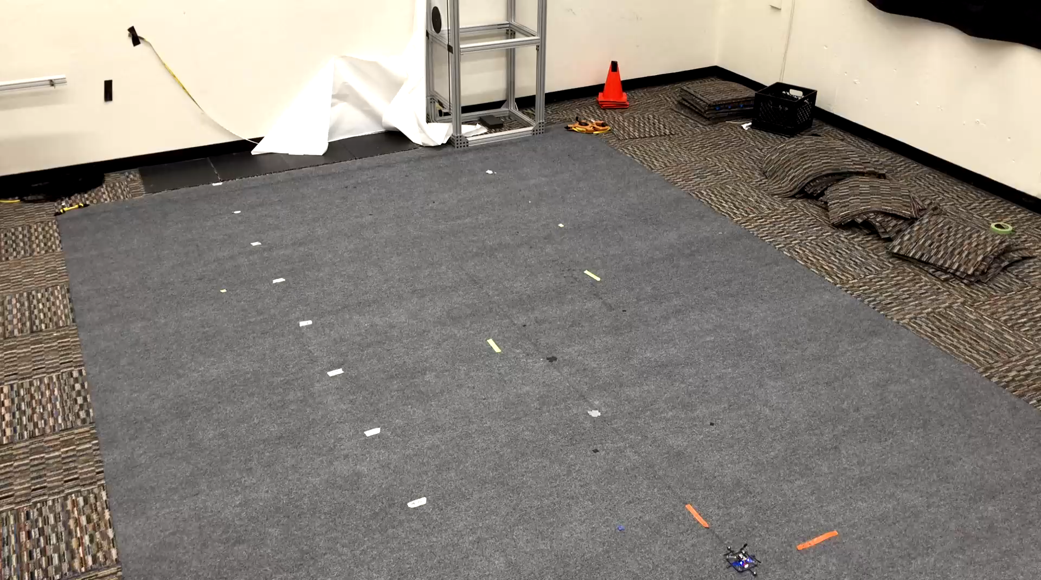
Platoon Forming
Notes:
2 min

Slide 40
Safety

Slide 41
Practical challenges

Slide 42
Future work
LQR
Haptic
Inverted pendulum
GPS mimicking
Partial state information

Slide 43
Summary

